Slide 1
e-Banking
e-Banking System is the new phase of banking system which help nation to go cashless and help to preserve natural resource.
Group member:-
1.AMANDEEP SINGH 2.Aryan raj
3.Abhinav kumar 4.KrishNa kamal mAndal
5.Susmita dutta 6.Saibal Kumar pradhan

Slide 2

Introduction
Online banking, also known as internet banking, e-banking or virtual banking, is an electronic payment system that enables customers of a bank or other financial institution to conduct a range of financial transactions through the financial institution's website. The online banking system will typically connect to or be part of the core banking system operated by a bank and is in contrast to branch banking which was the traditional way customers accessed banking services.

Slide 3
Scope
Today the customer demands the services of banks 24 hours where he lives even he is in the airplane. Now in this modern age the entire banking structure has been changed due to widespread internet technology. Now all the business-like commerce, trade, import, export, purchase and sale of goods is relying upon electronic banking. By using the advance electronic technology, the banking services are fast and economical.
There is a saving time and saving of money in the use of e-banking. If any country wants to work in the world market, it will have to improve the banking services at international level because old traditional banking is not acceptable in the changing global economy.

Slide 4
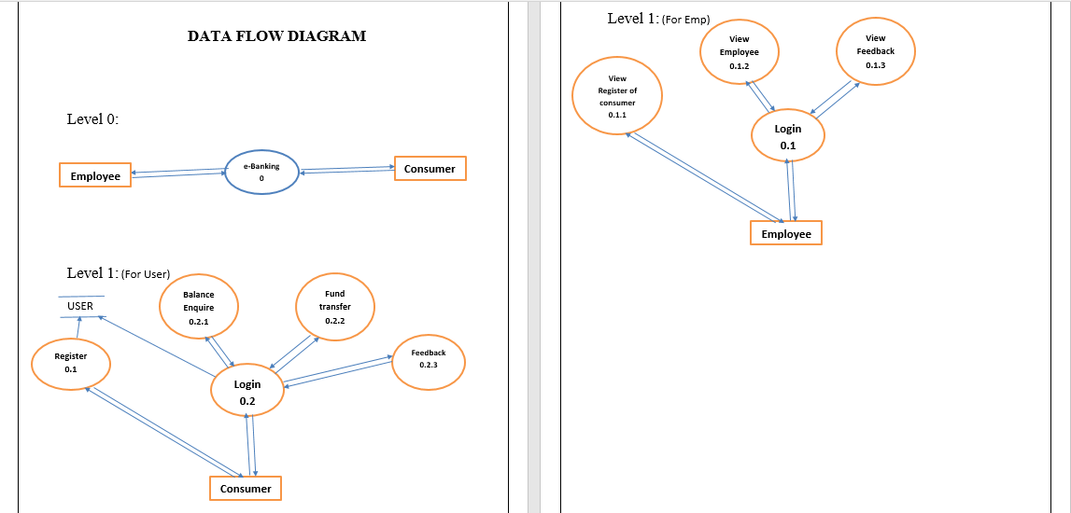
Data Flow Diagram :-

Slide 5
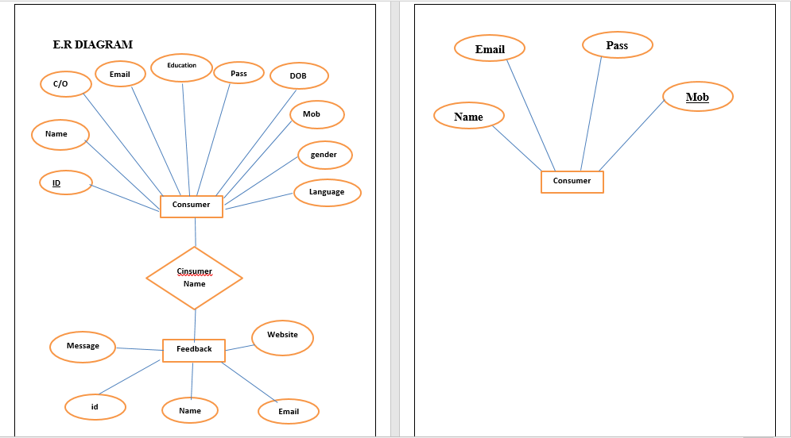
E-R DIAGRAM :-

Slide 6
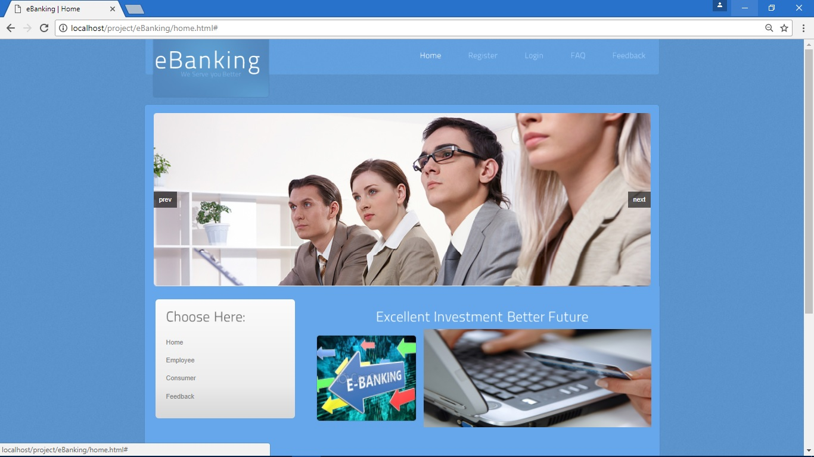
ScreenShots :-

Slide 7
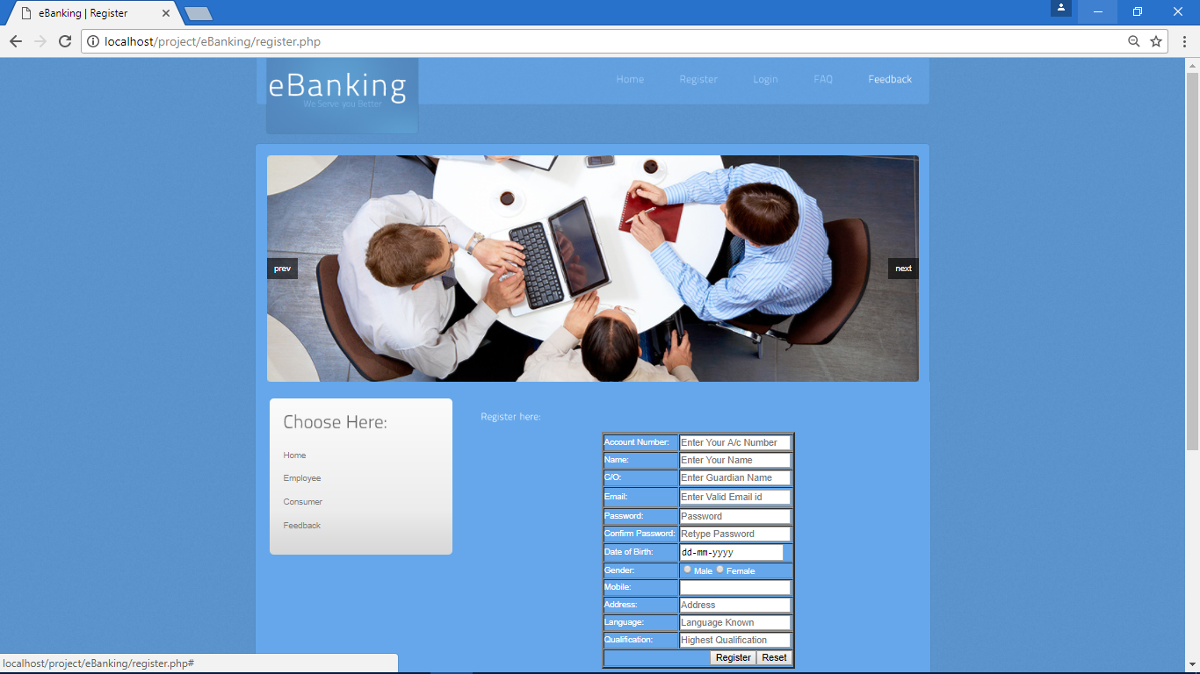
Screenshots :-

Slide 8
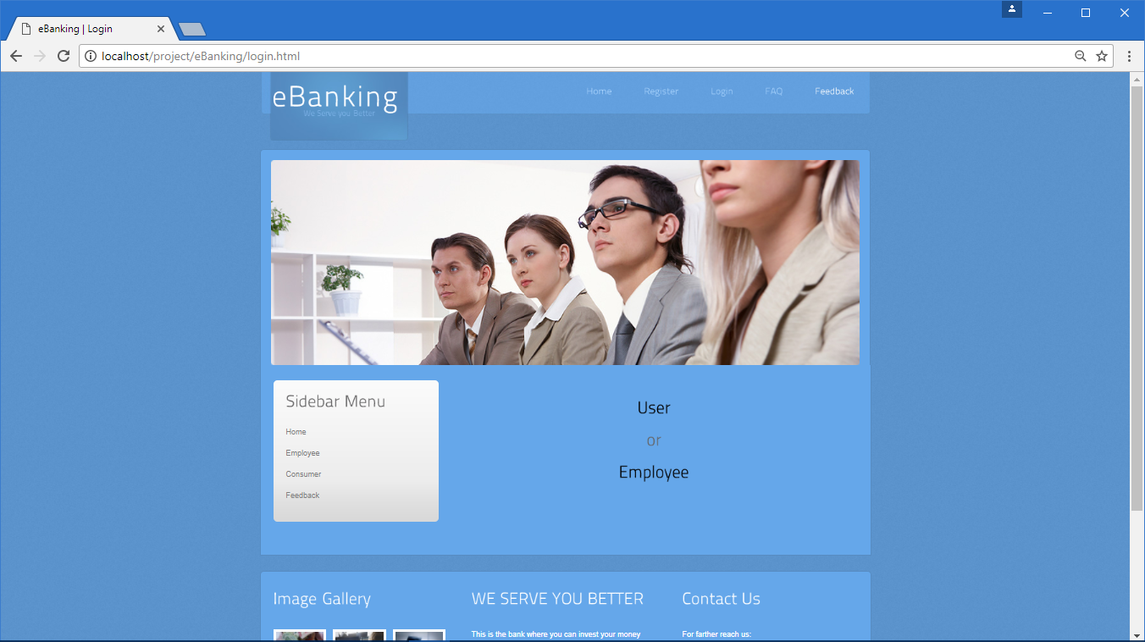
Screenshots :-

Slide 9
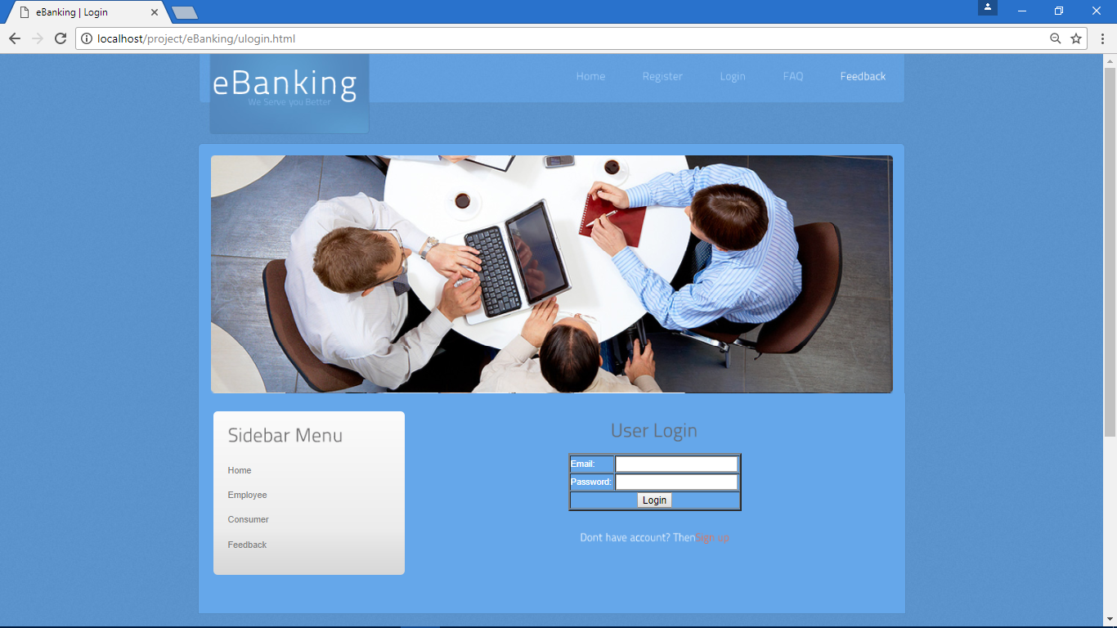
Screenshots :-

Slide 10
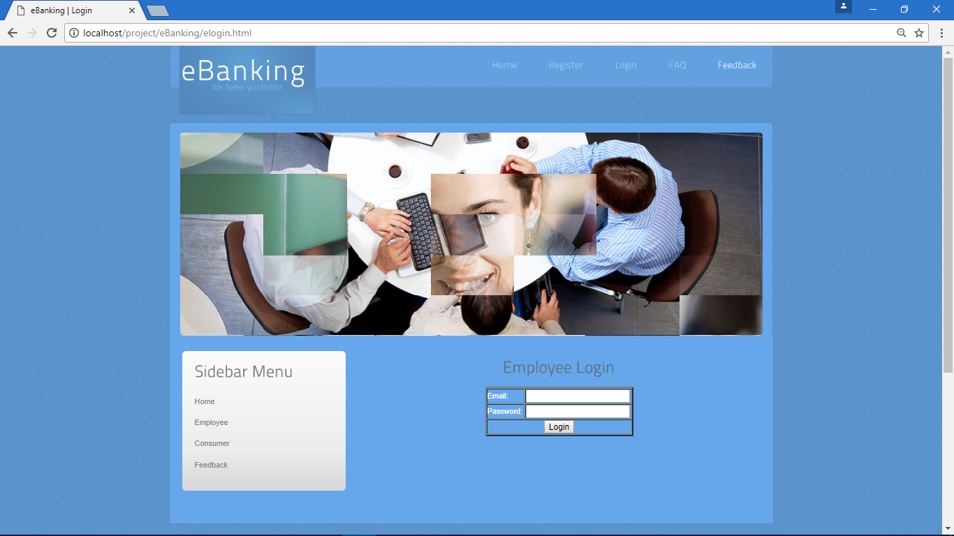
ScreenShots :-

Slide 11
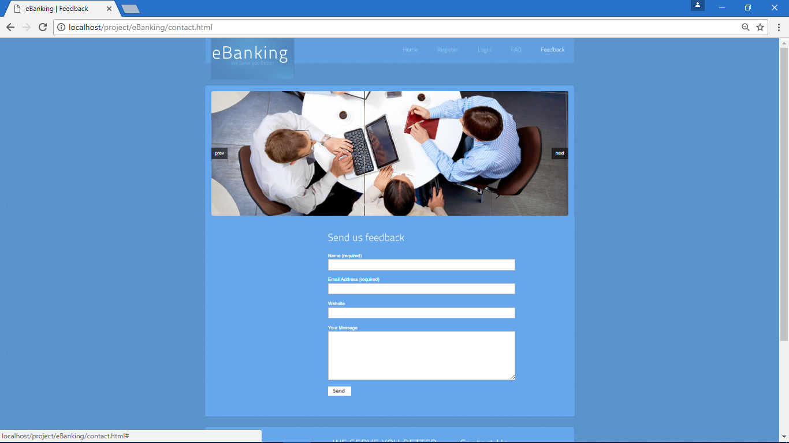
Screenshots :-

Slide 12
Future Scope
In future, we would like to keep working on this project and make new additions to provide users with more advanced features and more detailed information. We have set our sights on the following additions in future :-
Addition of More Secure System.
More Interactive User Interface for The User.
Going Cashless.

Slide 13
Conclusion :-
This project has been appreciated by all the users in the organization. It is easy to use, since it uses the GUI provided in the user dialog. User friendly screens are provided. The usage of software increases the efficiency, decreases the effort. It has been efficiently employed as a Site management mechanism. It has been thoroughly tested and implemented.
The project “e-Banking System” is the ideal Project for every customer who will get all the information about the e-Banking System, how to manage his account, doing fund transfer etc. It will provide user the benefit e-Banking with giving enough facility one click away sitting in his home without having to make the long walk and standing in queues.

